Slide 1


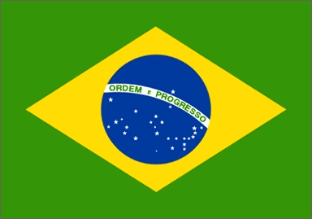

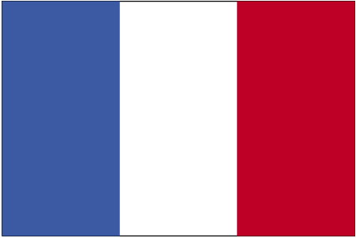







and nationalities
GAME

Slide 2

You have 5 seconds to guess where they are from and what are their nationalities. Let’s start!
PLAY

Slide 3


He is from …
Argentina
France
Poland
Portugal
Turkey
Spain
Britain
Germany
Italy
Sweden
Greece
Ireland
Morocco
Thailand
Peru
Mexico
Brazil
Japan
Chile
TIME’S UP
USA
China
NEXT

Slide 4
He is …
Portuguese
Chilean
Greek
Argentinian
Moroccan
Peruvian
German
British
Italian
Mexican
Polish
Irish
Turkish
Spanish
Chinese
Swedish
Brazilian
French
American
TIME’S UP
Japanese
Thai
NEXT

Slide 5
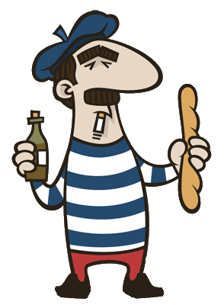
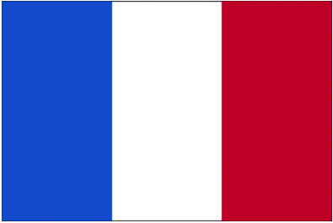
He is from …
Argentina
France
Poland
Portugal
Turkey
Spain
Britain
Germany
Italy
Sweden
Greece
Ireland
Morocco
Thailand
Peru
Mexico
Brazil
Japan
Chile
TIME’S UP
USA
China
NEXT

Slide 6
He is …
Portuguese
Chilean
Greek
Argentinian
Moroccan
Peruvian
German
British
Italian
Mexican
Polish
Irish
Turkish
Spanish
Chinese
Swedish
Brazilian
French
American
TIME’S UP
Japanese
Thai
NEXT

Slide 7
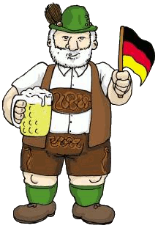
He is from …
Argentina
France
Poland
Portugal
Turkey
Spain
Britain
Germany
Italy
Sweden
Greece
Ireland
Morocco
Thailand
Peru
Mexico
Brazil
Japan
Chile
TIME’S UP
USA
China
NEXT

Slide 8
He is …
Portuguese
Chilean
Greek
Argentinian
Moroccan
Peruvian
German
British
Italian
Mexican
Polish
Irish
Turkish
Spanish
Chinese
Swedish
Brazilian
French
American
TIME’S UP
Japanese
Thai
NEXT

Slide 9
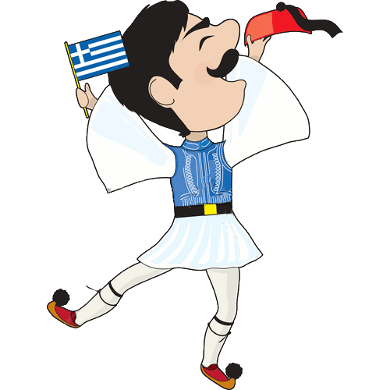
He is from …
Argentina
France
Poland
Portugal
Turkey
Spain
Britain
Germany
Italy
Sweden
Greece
Morocco
Ireland
Thailand
Peru
Mexico
Brazil
Japan
Chile
TIME’S UP
USA
China
NEXT

Slide 10
He is …
Portuguese
Chilean
Greek
Argentinian
Moroccan
Peruvian
German
British
Italian
Mexican
Polish
Irish
Turkish
Spanish
Chinese
Swedish
Brazilian
French
American
TIME’S UP
Japanese
Thai
NEXT

Slide 11


He is from …
Argentina
France
Poland
Portugal
Turkey
Spain
Britain
Germany
Italy
Sweden
Greece
Ireland
Morocco
Thailand
Peru
Mexico
Brazil
Japan
Chile
TIME’S UP
USA
China
NEXT

Slide 12
He is …
Portuguese
Chilean
Greek
Argentinian
Moroccan
Peruvian
German
British
Italian
Mexican
Polish
Irish
Turkish
Spanish
Chinese
Swedish
Brazilian
French
American
TIME’S UP
Japanese
Thai
NEXT

Slide 13
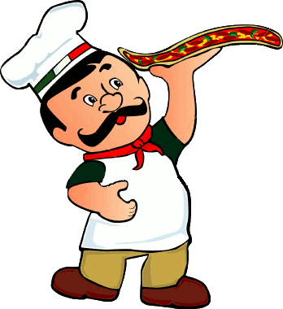

He is from …
Argentina
France
Poland
Portugal
Turkey
Spain
Britain
Germany
Italy
Sweden
Greece
Ireland
Morocco
Thailand
Peru
Mexico
Brazil
Japan
Chile
TIME’S UP
USA
China
NEXT

Slide 14
He is …
Portuguese
Chilean
Greek
Argentinian
Moroccan
Peruvian
German
British
Italian
Mexican
Polish
Irish
Turkish
Spanish
Chinese
Swedish
Brazilian
French
American
TIME’S UP
Japanese
Thai
NEXT

Slide 15


He is from …
Argentina
France
Poland
Portugal
Turkey
Spain
Britain
Germany
Italy
Sweden
Greece
Ireland
Morocco
Thailand
Peru
Mexico
Brazil
Japan
Chile
TIME’S UP
USA
China
NEXT

Slide 16
He is …
Portuguese
Chilean
Greek
Argentinian
Moroccan
Peruvian
German
British
Italian
Mexican
Polish
Irish
Turkish
Spanish
Chinese
Swedish
Brazilian
French
American
TIME’S UP
Japanese
Thai
NEXT

Slide 17
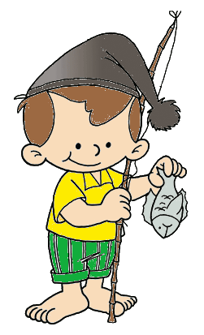
He is from …
Argentina
France
Poland
Portugal
Turkey
Spain
Britain
Germany
Italy
Sweden
Greece
Ireland
Morocco
Thailand
Peru
Mexico
Brazil
Japan
Chile
TIME’S UP
USA
China
NEXT

Slide 18
He is …
Portuguese
Chilean
Greek
Argentinian
Moroccan
Peruvian
German
British
Italian
Mexican
Polish
Irish
Turkish
Spanish
Chinese
Swedish
Brazilian
French
American
TIME’S UP
Japanese
Thai
NEXT

Slide 19
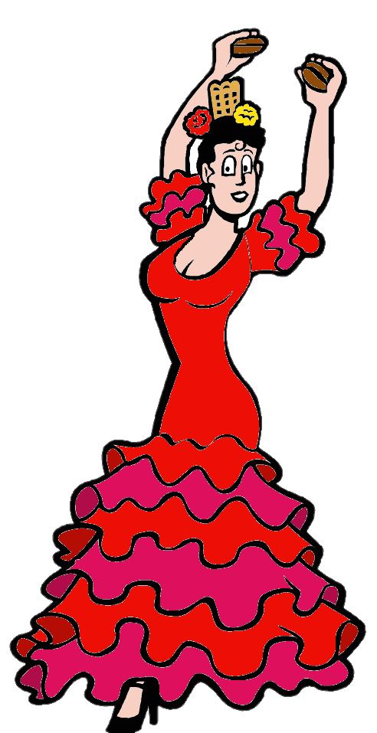
She is from …
Argentina
France
Poland
Portugal
Turkey
Spain
Britain
Germany
Italy
Sweden
Greece
Ireland
Morocco
Thailand
Peru
Mexico
Brazil
Japan
Chile
TIME’S UP
USA
China
NEXT

Slide 20
She is …
Portuguese
Chilean
Greek
Argentinian
Moroccan
Peruvian
German
British
Italian
Mexican
Polish
Irish
Turkish
Spanish
Chinese
Swedish
Brazilian
French
American
TIME’S UP
Japanese
Thai
NEXT

Slide 21
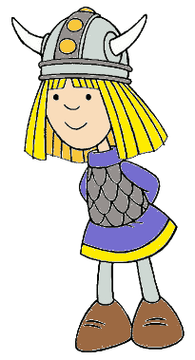
He is from …
Argentina
France
Poland
Portugal
Turkey
Spain
Britain
Germany
Italy
Sweden
Greece
Ireland
Morocco
Thailand
Peru
Mexico
Brazil
Japan
Chile
TIME’S UP
USA
China
NEXT

Slide 22
He is …
Portuguese
Chilean
Greek
Argentinian
Moroccan
Peruvian
German
British
Italian
Mexican
Polish
Irish
Turkish
Spanish
Chinese
Swedish
Brazilian
French
American
TIME’S UP
Japanese
Thai
NEXT

Slide 23


He is from …
Argentina
France
Poland
Portugal
Turkey
Spain
Britain
Germany
Italy
Sweden
Greece
Ireland
Morocco
Thailand
Peru
Mexico
Brazil
Japan
Chile
TIME’S UP
USA
China
NEXT

Slide 24
He is …
Portuguese
Chilean
Greek
Argentinian
Moroccan
Peruvian
German
British
Italian
Mexican
Polish
Irish
Turkish
Spanish
Chinese
Swedish
Brazilian
French
American
TIME’S UP
Japanese
Thai
NEXT

Slide 25


Argentina
France
Poland
Portugal
Turkey
Spain
Britain
Germany
Italy
Sweden
Greece
Ireland
Morocco
Thailand
Peru
Mexico
Brazil
Japan
Chile
TIME’S UP
USA
China
NEXT

Slide 26
He is …
Portuguese
Chilean
Greek
Argentinian
Moroccan
Peruvian
German
British
Italian
Mexican
Polish
Irish
Turkish
Spanish
Chinese
Swedish
Brazilian
French
American
TIME’S UP
Japanese
Thai
NEXT

Slide 27


He is from …
Argentina
France
Poland
Portugal
Turkey
Spain
Britain
Germany
Italy
Sweden
Greece
Morocco
Ireland
Peru
Thailand
Brazil
Mexico
Japan
Chile
TIME’S UP
USA
China
NEXT

Slide 28
He is …
Portuguese
Chilean
Greek
Argentinian
Moroccan
Peruvian
German
British
Italian
Mexican
Polish
Irish
Turkish
Spanish
Chinese
Swedish
Brazilian
French
American
TIME’S UP
Japanese
Thai
NEXT

Slide 29

He is from …
Argentina
France
Poland
Portugal
Turkey
Spain
Britain
Germany
Italy
Sweden
Greece
Morocco
Ireland
Thailand
Peru
Mexico
Brazil
Japan
Chile
TIME’S UP
USA
China
NEXT

Slide 30
He is …
Portuguese
Chilean
Greek
Argentinian
Moroccan
Peruvian
German
British
Italian
Mexican
Polish
Brazilian
Turkish
Spanish
Chinese
Swedish
Irish
French
American
TIME’S UP
Japanese
Thai
NEXT

Slide 31
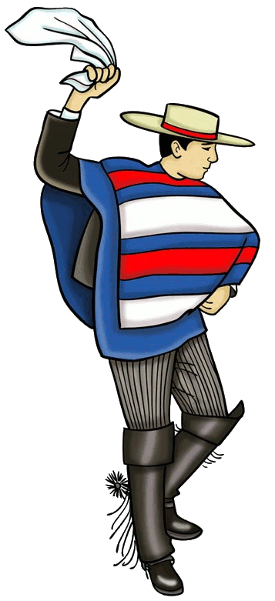

He is from …
Argentina
France
Poland
Portugal
Turkey
Spain
Britain
Germany
Italy
Sweden
Greece
Morocco
Ireland
Thailand
Peru
Mexico
Brazil
Japan
Chile
TIME’S UP
USA
China
NEXT

Slide 32
He is …
Portuguese
Chilean
Greek
Argentinian
Moroccan
Peruvian
German
British
Italian
Mexican
Polish
Irish
Turkish
Spanish
Chinese
Swedish
Brazilian
French
American
TIME’S UP
Japanese
Thai
NEXT

Slide 33

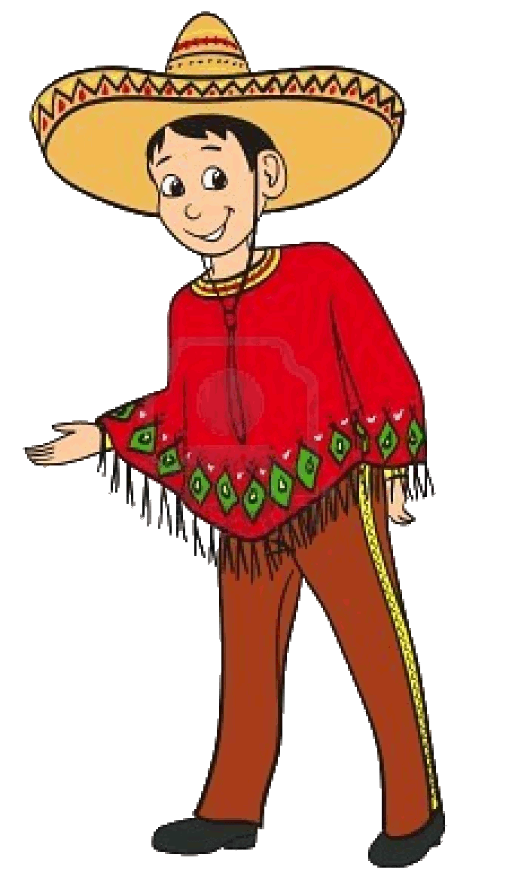
He is from …
Argentina
France
Poland
Portugal
Turkey
Spain
Britain
Germany
Italy
Sweden
Greece
Morocco
Ireland
Peru
Thailand
Brazil
Mexico
Japan
Chile
TIME’S UP
USA
China
NEXT

Slide 34
He is …
Portuguese
Chilean
Greek
Argentinian
Moroccan
Peruvian
German
British
Italian
Mexican
Polish
Irish
Turkish
Spanish
Chinese
Swedish
Brazilian
French
American
TIME’S UP
Japanese
Thai
NEXT

Slide 35

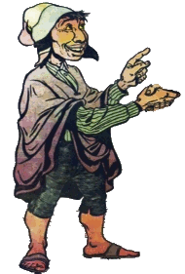
He is from …
Argentina
France
Poland
Portugal
Turkey
Spain
Britain
Germany
Italy
Sweden
Greece
Ireland
Morocco
Thailand
Peru
Mexico
Brazil
Japan
Chile
TIME’S UP
USA
China
NEXT

Slide 36
He is …
Portuguese
Chilean
Greek
Argentinian
Moroccan
Peruvian
German
British
Italian
Mexican
Polish
Irish
Turkish
Spanish
Chinese
Swedish
Brazilian
French
American
TIME’S UP
Japanese
Thai
NEXT

Slide 37

He is from …
Argentina
France
Poland
Portugal
Turkey
Spain
Britain
Germany
Italy
Sweden
Greece
Ireland
Morocco
Thailand
Peru
Mexico
Brazil
Japan
Chile
TIME’S UP
USA
China
NEXT

Slide 38
He is …
Portuguese
Chilean
Greek
Argentinian
Moroccan
Peruvian
German
British
Italian
Mexican
Polish
Irish
Turkish
Spanish
Chinese
Swedish
Brazilian
French
American
TIME’S UP
Japanese
Thai
NEXT

Slide 39
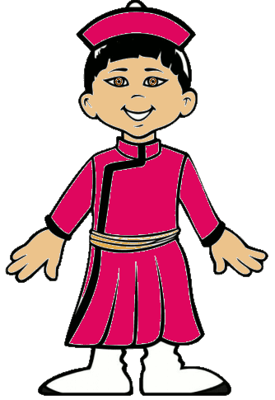

He is from …
Argentina
France
Poland
Portugal
Turkey
Spain
Britain
Germany
Italy
Sweden
Greece
Ireland
Morocco
Thailand
Peru
Mexico
Brazil
Japan
Chile
TIME’S UP
USA
China
NEXT

Slide 40
He is …
Portuguese
Chilean
Greek
Argentinian
Moroccan
Peruvian
German
British
Italian
Mexican
Polish
Irish
Turkish
Spanish
Chinese
Swedish
Brazilian
French
American
TIME’S UP
Japanese
Thai
NEXT

Slide 41


She is from …
Argentina
France
Poland
Portugal
Turkey
Spain
Britain
Germany
Italy
Sweden
Greece
Morocco
Ireland
Thailand
Peru
Brazil
Mexico
Japan
Chile
TIME’S UP
USA
China
NEXT

Slide 42
She is …
Portuguese
Chilean
Greek
Argentinian
Moroccan
Peruvian
German
British
Italian
Mexican
Polish
Irish
Turkish
Spanish
Chinese
Swedish
Brazilian
French
American
TIME’S UP
Japanese
Thai
NEXT

Slide 43
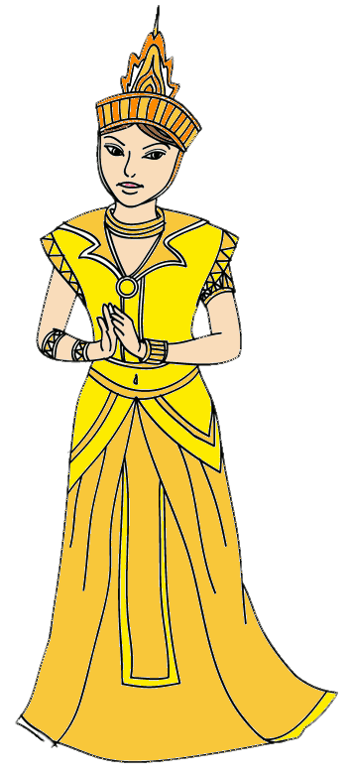

She is from …
Argentina
France
Poland
Portugal
Turkey
Spain
Britain
Germany
Italy
Sweden
Greece
Morocco
Ireland
Thailand
Peru
Brazil
Mexico
Japan
Chile
TIME’S UP
USA
China
NEXT

Slide 44
She is …
Portuguese
Chilean
Greek
Argentinian
Moroccan
Peruvian
German
British
Italian
Mexican
Polish
Irish
Turkish
Spanish
Chinese
Swedish
Brazilian
French
American
TIME’S UP
Japanese
Thai
NEXT

Slide 45
CONGRATULATIONS!
WELL DONE!
EXIT

